Slide 1

Project 3:
Web APIs & NLP
Nolan Arendt

Slide 2

Defining Maturity Through Words
Determine if a model can predict if a post is from the adults subreddit , or teenagers subreddit.
What are the most common words for adults? Teenagers?
Can we accurately predict a users age based off of the words that they use?

Slide 3


Project WorkFlow
Data Collection with PushShift API
2. Data Cleaning & EDA
3. Preprocessing & Modeling
4. Evaluation
5. Conclusions & Recommendations

Slide 4

Classification of Two Subreddits
Collection of 5,000 posts per subreddit.
Can only collect 100 posts at a time using PushShift API.
Loop to collect 100 posts multiple times.
Cleaning of subreddit posts.
Combine title and body to create one column.
Remove null posts.
Preprocessing and Modeling
Adding stop words.
Balancing of classes (51% teenagers, 49% adults).
Naïve Bayes and KNN Models

Slide 5
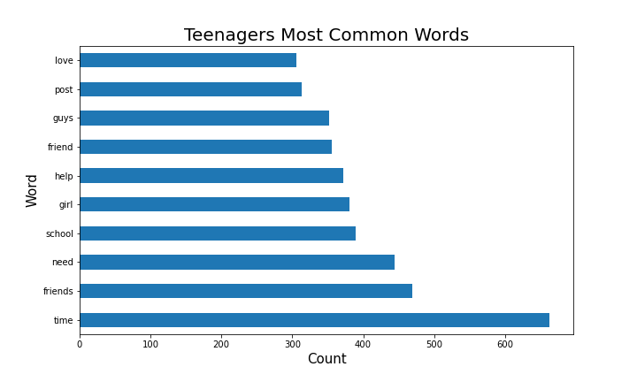


Teenagers Most Common Words

Slide 6
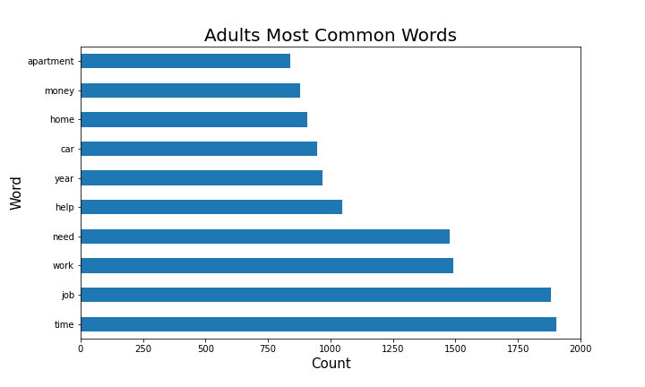


Adults Most Common Words

Slide 7
Classification of Two Subreddits
Evaluation
Model | Transformer | Training Score | Testing Score
Naïve Bayes | CountVectorizer | 0.938 | 0.914
 | TfidfVectorizer | 0.947 | 0.925
KNN | CountVectorizer | 0.812 | 0.753
 | TfidfVectorizer | 0.544 | 0.537

Slide 8

Best Model
Naïve Bayes, TfidfVectorizer
Training Score : 0.947
Testing Score : 0.925
Max Features | NGram Range | Stop Words
5000 | (1, 2) | English

Slide 9
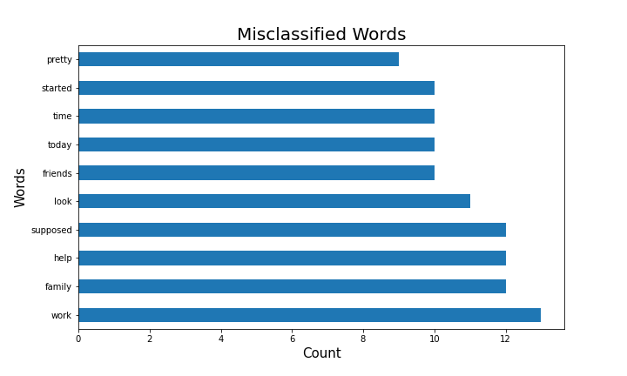

Misclassified Words
Only adult posts were misclassified!

Slide 10
Classification of Two Subreddits
Conclusion and Recommendations
Naïve Bayes was best scoring model.
TfidfVectorizer scored better for Naive Bayes model.
CountVectorizer scored better for KNN model.
Model was a success! Minimal misclassifications.

Slide 11

Future Research
More age specific subreddits.
Generations, decades, etc.
Include comments into analysis.
Geographical common words.
West coast, east coast, midwest, etc.

Slide 12





Questions?
Thank you!
https://www.linkedin.com/in/nolanarendt/
https://git.generalassemb.ly/nolanarendt
nolanarendt10@gmail.com

